Slide 1
Section #4
October 30th 2009
Old: Review the Midterm
& old concepts
New: Case II t-Tests (Chapter 11)

Slide 2
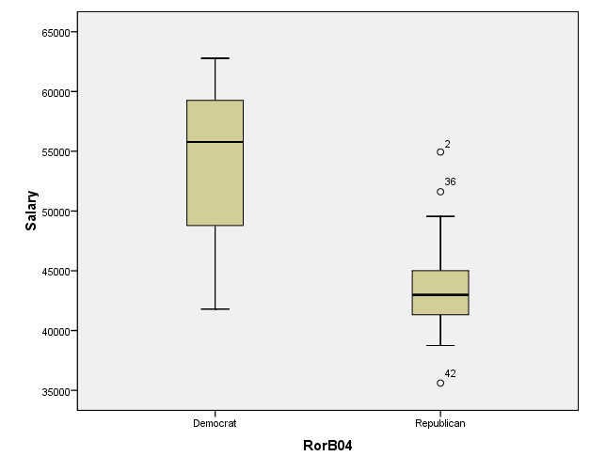
State Question
Ohio
Alaska
South Dakota

Slide 4
Review of Concepts
Let’s revisit the following, and how they are related…
  Null & alternative hypotheses
  Variance & standard deviation
  Sampling distribution
  Critical value (level of significance, α)
  Confidence interval
  Test statistic (p-value)
  The t- and the z-table

Slide 5
Hypothesis Testing
Null Hypothesis: A hypothesis to be tested.
We use the symbol H₀ to denote (e.g. H₀ : μ=0)
Alternative Hypothesis: A hypothesis to be considered as an alternative to the null hypothesis.
We use the symbol H_{A} to denote. (e.g. H_{A} : μ≠0)
Hypothesis Test: The test of whether the null hypothesis (H₀) should be rejected in favor of the alternative hypothesis.

Slide 6
Variance & Standard Deviation
Variance
Standard
Deviation

Slide 7
We Sampling Distributions
Sample distribution: Based on a randomly selected subset of population
  We directly calculate these things, and they’re our best estimate of the population
Population distribution: Based on all the members of a population
  Usually we DON’T know these things, but hope to ESTIMATE them
Sampling distribution: Based on mean and sd of sample statistics
  These distributions capture our uncertainty about how well our sample statistics represent the population parameters!
  They allow us to draw inferences about the population without having to sample the entire population.

Slide 8
Central Limit Theorem
If the average salary of teachers in the U.S. is $49,000 with a standard deviation of $10,000, what is the mean and standard deviation of the sampling distribution? Do your answers depend on the shape of the distribution of teacher salaries in the population?
CLT: When n is large, we know our sampling distributions of a mean will be approximately normal.
How large is large?
In practice, the sampling distribution is usually close to normal when the sample size is at least about 30. In the midterm example, the samples were 100 and 400, so the shape of the sampling distributions will be approximately normal, regardless of the shape of the underlying population distribution from when the sample was drawn.

Slide 9
Standard Error of Sampling Means
Standard error is a particular kind of standard deviation: it applies to sampling distributions!

Slide 10
significance levels (α) critical values
the significance level (α) is the probability of rejecting a true null hypothesis (between 0-1)
by looking up your desired significance (α)and whether you want a one or two-tail test in the t-table, you can find the t-score (called a “critical value”) for different sample sizes (df = n-1). This tells you how many standard deviations away from the expected population mean you need to go in order to be outside the 95% range (with α = 0.05)
Q: do you need to know both the alpha and the critical value to do a hypothesis test?

Slide 11
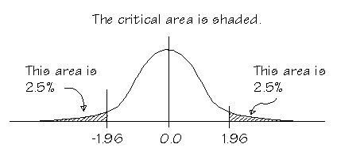
Relationship between critical value and significance level (α, alpha)
two-tail test
Critical value = 1.96
α = 0.05

Slide 12
confidence intervals
Confidence intervals describe the range of possible population mean values that you could reasonably expect your sample mean to have come from.
Picture a sampling distribution around that sample mean. You know that 95% of the expected means will fall within roughly 2 standard errors of your sample mean
(t = critical value of t for df = N - 1, two-tailed)

Slide 13
Test statistics: z-scores & t-scores
for sampling means
z
t
Notes:
Only difference is that we don’t know sigma, so when we calculate t, it uses the standard error of the means that is calculated with s, which is slightly larger because we aren’t quite sure.

Slide 14
Test statistic & p-values
The p-value is the probability of obtaining your test statistic (z-score or t-score)
Z: look it up in the z-table in the back of the book (0-50)
T: you can’t find this using the t-table because they wanted to save on space and so only showed the common significance levels, so that you could compute the critical values… BUT computer programs will give you p-values associated with your t-statistics.

Slide 15
the actual test test statistic & critical values
If the t/z-score > critical value, then you can reject the null hypothesis and conclude that your sample is “statistically different” from the general population. ( OR p-value < alpha/2)
If the t/z-score < critical value, then you “fail to reject the null” and need to continue to assume that the sample is part of the general population. (OR p-value > alpha/2)

Slide 16
Case II t-Tests (Chapter 11)
How to compare two groups (for example, let’s say we wanted to compare boys and girls or big schools and small schools)
How to work with the sampling distribution of the difference between two means

Slide 17
Hypothesis Testing
Step 1: State the hypotheses H₀ & H_{A} that you are testing
Step 2: Calculate the t-statistic for the difference in sample means
  The only difference between this and the z-score or one sample t-test is that you calculate the standard error differently to account for the fact that you have two different samples.
Step 3: Compare your t-statistic to the critical value (calculated from the alpha that you are aiming for) in order to decide whether or not you can reject your null hypothesis (H₀).
Notes:
H₀: μ = 100

Slide 18
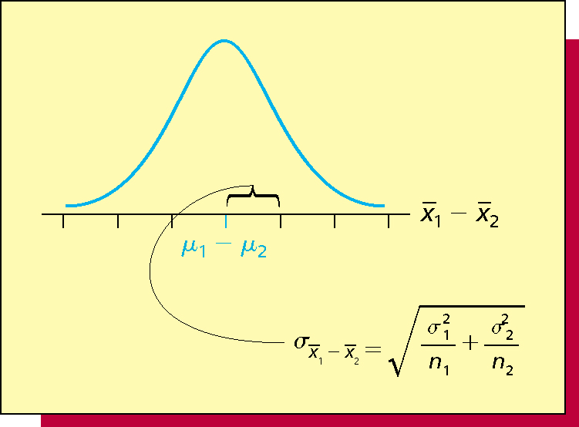
Sampling distribution of
This is just like what we have done except that we have a our new variable of interest is the difference between two means

Slide 19
Two Options
Independent Means: Two different samples
Dependent Means: Two observations from the same sample

Slide 20
1. Independent Means
Testing hypotheses about whether two different samples come from the same or different populations.

Slide 21
Calculating the t-statistic for independent means
Step 2a: Compute Pooled Variance
In essence, this is just an average measure of the variance across the two samples.
SS_{w} SS₁ + SS₂
s_{p}² =
=
N-2 N-2
Q: But wait! We have basically been using standard deviation so far, why are we using variance now? What is the relationship between the two?
Notes:
This is the formula Kenji showed you in class. It is the same as the formula given in the book on page 173, just algebraically manipulated such that the book formula is in terms of the sample variances (s squared) while Kenji’s formula is in terms of the sum of squares (SS). Remember s squared (variance) = SS/N, therefore SS = S squared * N.

Slide 22
Calculating the t-statistic for independent means
Step 2b: Compute Standard Error
s_{p}² s_{p}²
s_{X1-X2} =
+
N₁ N₂
SS_{w} SS₁ + SS₂
s_{p}² =
=
N-2 N-2
Q: But wait! Before our formula for standard error was just standard deviation divided by the square root of N? Why is this different?
Notes:
We know standard error = s/square root N. This is equal the squared error term equaling s squared/N.

Slide 23
Calculating the t-statistic for independent means
Step 2c: Compute t-statistic
(X₁ - X₂) - (μ₁ - μ₂ )
t =
s_{X1-X2}
Q: But wait! Often our null hypothesis will be that we expect no change. Can we simplify this formula?

Slide 24
2. Dependent Means
Two measurements on the same person, thus they are dependent.
This is our anorexia problem. Now we have the skills to do it justice.

Slide 25
Calculating the t-statistic for dependent means
Step 2a: Compute sd of difference
In essence, if you took each pre- and post-weight, and made a new column for weight change, this is a measure of the spread of those changes.
X bar = mean weight change, X = each individual weight change
Notes:
Remember relationship between standard deviation and variance – just a square root!

Slide 26
Calculating the t-statistic for independent means
Step 2b: Compute Standard Error
Q: This looks familiar! It should – nothing is different from our one sample t-test!

Slide 27
Calculating the t-statistic for independent means
Step 2c: Compute t-statistic
X₁ - X₂
t =
s_{X1-X2}
Q: And this is the same as the two-sample t-test for independent means!

Slide 28
Anorexia Question
A recent study compared different psychological therapies for teenage girls suffering from anorexia, an eating disorder that can cause them to become dangerously underweight.
Each girl’s weight was measured before and after a period of therapy.
The variable of interest was weight change, defined as weight at the end of the study minus the weight at the beginning of the study.
The weight change variable was positive if the individual gained weight and negative if she lost weight.
It is feasible that weight could increase or decrease in response to the therapy.
In this study, 29 girls received a new experimental therapy. The data from the study (anorexia.sav) can be found on the course website.

Slide 29
Anorexia Question
Calculatethe mean weight change, the standard deviation of weight change, and standard error of the sampling mean.
What are the null and alternative hypotheses?
What kind of test should you use (right, left, two-tailed)? Justify your choice. What is the critical value at alpha = 0.05?
What is the z-score that you obtained in your analysis? How does this compare to the critical value? What does that mean?
What conclusion can you draw from your analysis?

